Slide 1
Lte Advanced

Slide 2
Introduction to Lte advanced
LTE Advanced adds a number of additional capabilities to the basic LTE to provide very must higher data rates and mush better performance.
LTE provides improved performance particularly at cell edges and other areas where performance would not normally have been so good.

Slide 3
Lte advanced key Features
Peak data rates: downlink - 1 Gbps; uplink - 500 Mbps.
Spectrum efficiency: 3 times greater than LTE.
Spectrum use: the ability to support scalable bandwidth use and spectrum aggregation where non-contiguous spectrum needs to be used.
Latency: from Idle to Connected in less than 50 ms and then shorter than 5 ms one way for individual packet transmission.
Cell edge user throughput to be twice that of LTE.
Average user throughput to be 3 times that of LTE.
Mobility: Same as that in LTE
Compatibility: LTE Advanced shall be capable of interworking with LTE and 3GPP legacy systems

Slide 4
Lte advanced key functions
Carrier aggregation: This allows for the bonding of multiple LTE carriers together to create a larger pipe for data. This can more than double the potential data rates.
MIMO: This stands for multiple-input, multiple-output. It is a technology that can greatly increase data rates and capacity by using multiple antennas at both the transmitter and receiver.
Relay nodes: These are specialized base stations that can extend the range and coverage of the network.
Coordinated multipoint: This is a technology that allows for the use of multiple base stations at the same time to serve a single user. This can provide significant increases in data rates and capacity.

Slide 5
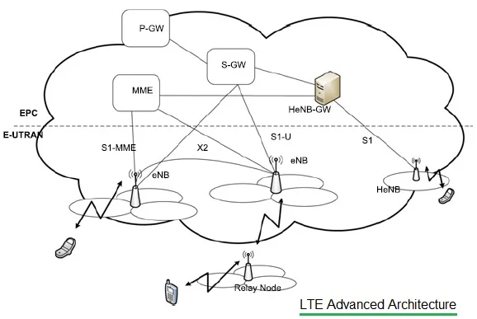
Lte advanced Architecture
P-GW: It stands for PDN Gateway. It interfaced with S-GW using S5 interface and with operator's IP services using SGi interface. It has connectivity with PCRP using Gx interface. It connects UE to packet data networks. P-GW assigns IP address to the UE.. It takes care of packet filtering, policy enforcement and charging related services.
S-GW: It stands for Serving Gateway. It interfaces with MME using S11 interface and with SGSN using S4 interface. It connects with PDN-GW using S5 interface as mentioned above. EPC gets terminated at this node/entity. It is connected with E-UTRAN via S1-U interface. Each UE in LTE-A is associated to unique S-GW which has several functions.
MME: It stands for Mobility Management Entity. It is major control plane element in LTE advanced architecture. It takes care of authentication, authorization and NAS signaling related security functions. It takes care of selecting either S-GW or PDN-GW or P-GW.
S1-MME: It provides connectivity between EPC and eNBs.
• eNB: It is main building block or system in LTE-A. It provides interface with UEs or LTE-A phones. It has similar functionality as base station used in GSM or other cellular systems. Each of the eNBs serve one or several E-UTRAN cells. Interface between two eNBs is known as X2 interface.
• HeNB: It stands for Home eNodeB or Home eNB.. It is used to improve coverage in the indoor region of office or home premises. It can be interfaced directly to EPC or via Gateway.
• HeNB-GW: It provides connectivity of HeNB with S-GW and MME. It aggregates all the traffic from number of Home eNBs to core network. It uses S1 interface to connect with HeNBs

